Slide 1


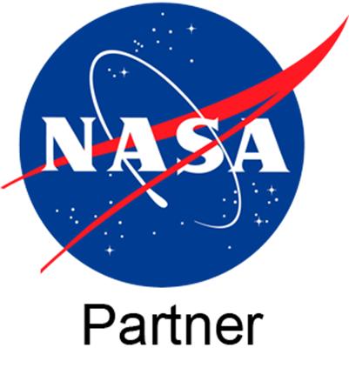
Science Writing at UArizona’s University Communications
Penny Duran
Mentored by Daniel Stolte
University Communications
Arizona Space Grant Statewide Student Research Symposium

Slide 2

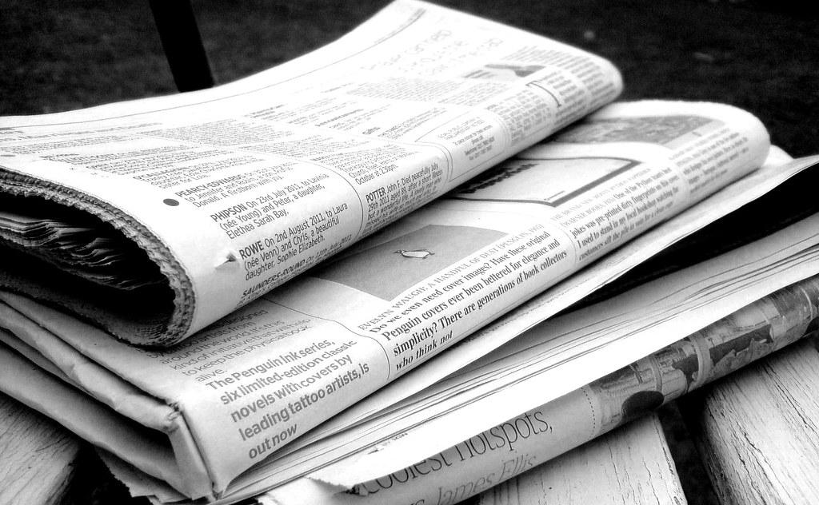
Why Science Writing?
Challenge: communicating science to general audiences
Storytelling techniques, everyday experiences, finding human angle
Working closely with scientists
Maintain accuracy, avoid oversimplification
+

Slide 3
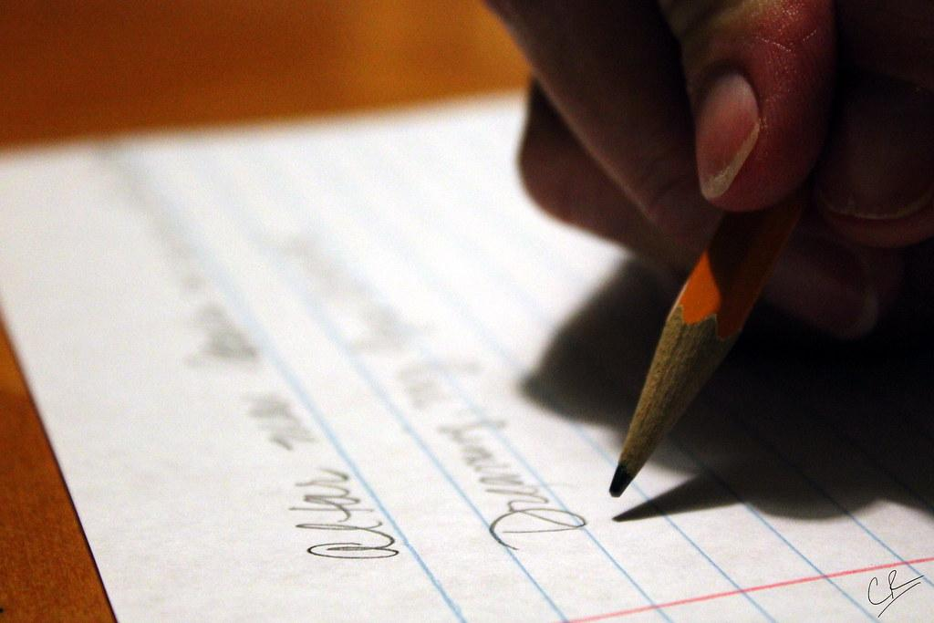
Writing an Article: What I Look For
What sparks my curiosity?
Human struggle and learning curve
Visuals and personal anecdotes
What drew researchers toward their fields
“In a nutshell” or “in plain language”

Slide 4
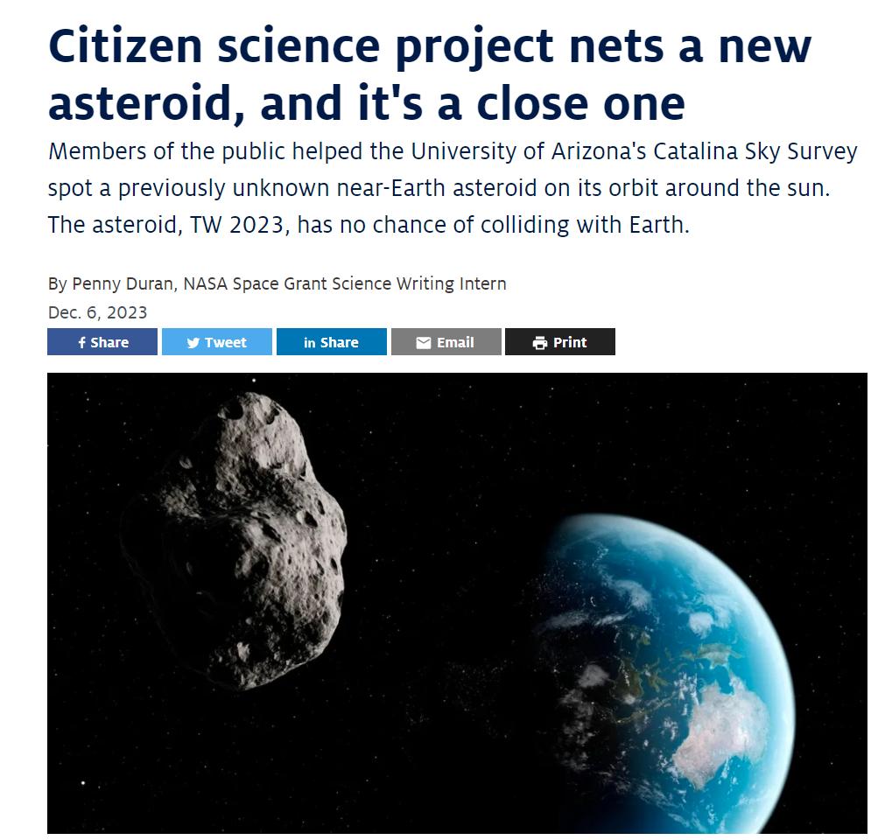
Making Science Tangible
"There is a sense of familiarity because almost everyone has seen movies like 'Deep Impact,' 'Armaggeddon' or 'Don't Look Up,' or might have even held a meteorite in their hands," Fuls said. "Because we work with images, it makes asteroids feel a lot more tangible." – Carson Fuls (UA Lunar and Planetary Lab, project leader)
New and firsts
Planetary defense
Familiarity
Notes:
Here’s a screenshot of my story on UANews

Slide 5
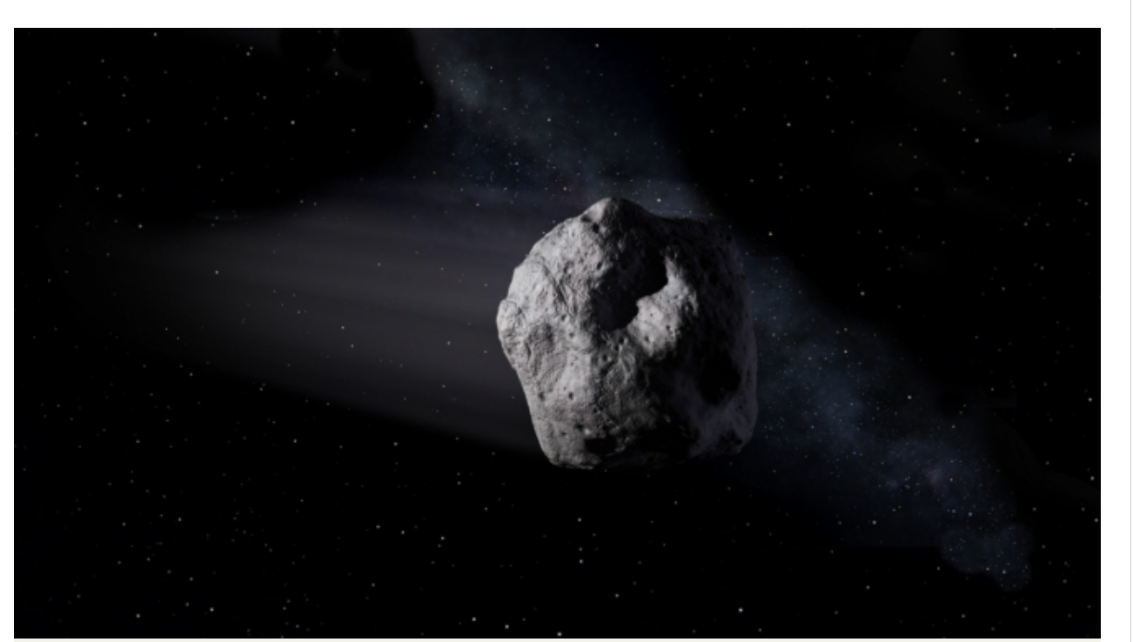
Citizen Science Voices
Community and collaboration
Accessibility of science
"Pattern recognition and spotting details are integral to my area of expertise. I work with old manuscripts, and to do well at that you do need a good eye for detail – which applies to identifying asteroids as well." – Elisabeth Chaghafi (historical researcher, Catalina Sky Survey volunteer)

Slide 6
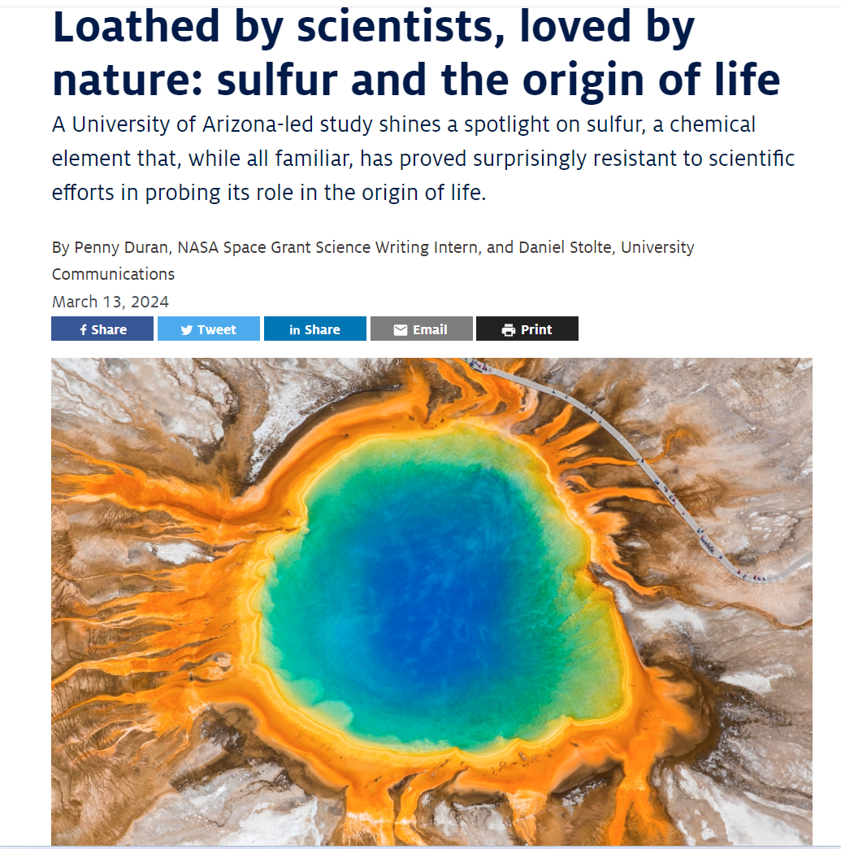
Prebiotic Earth:
Uncovering the Story
Technical nature of scientific paper
Story at core → origins of life
Human struggle of working with sulfur
Notes:
Here is my story as it appeared on UANews… then we put it on Eurek!Alert… portal from which other news outlets can pick it up

Slide 7
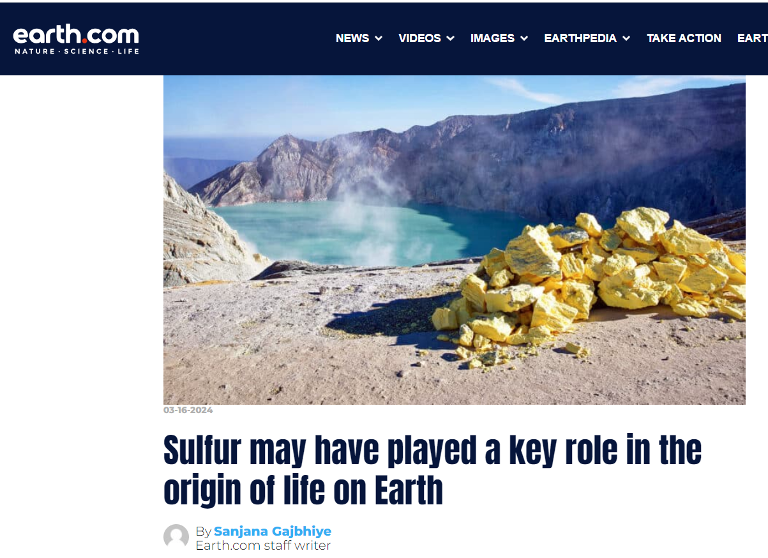
Our Number One Mission: Earned Media Coverage
Notes:
Earned media coverage as opposed to paid media coverage (we need convince that the story is interesting to cover).

Slide 8
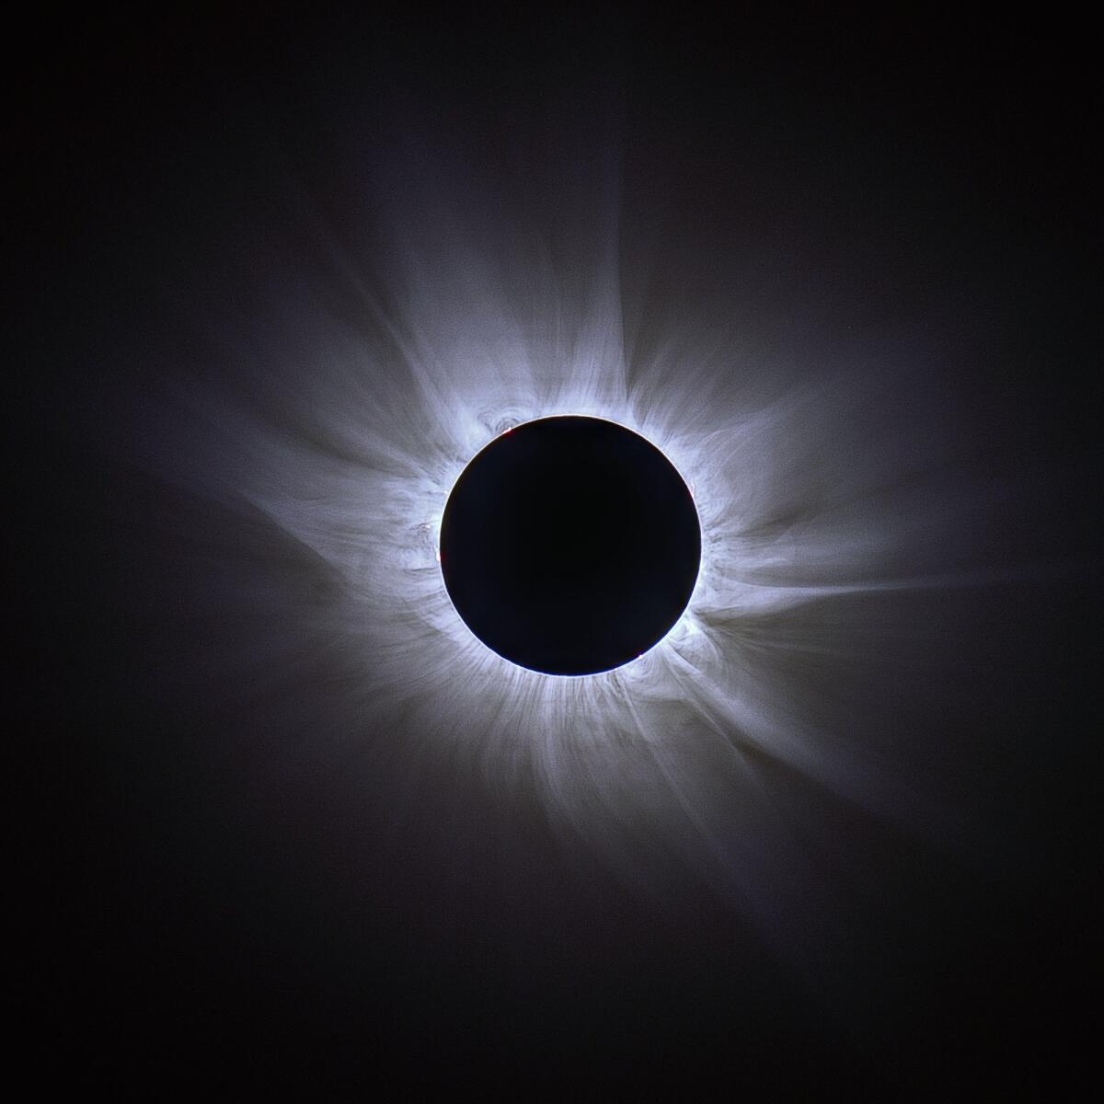
Current Events: The Great American Eclipse
Beyond the science
Wonder and curiosity through visual phenomena
Relevance throughout history
Give unsung stories recognition

Slide 9
Takeaways
Science writing…
provides relevance and broader societal impact
helps increase funding opportunities
makes it possible for scientists to reach wider audiences

Slide 10
Acknowledgements
Thank you!
I appreciate, Daniel Stolte, my mentor, for supporting and guiding me throughout this internship. I also acknowledge NASA Space Grant as well as the local directors and intern advisors for making this internship fun.
Thank you to all my interviewees for sharing their stories with me.

